Slide 1


Sprint 2 Review.
Aldrin Baretto, Momchil Badzhev, Jordan Keiller, Stewart Scrimgeour, Bruce Miller, Mikolaj Olejnik, Mohammed Tokaria.

Slide 2
Roles
Role | Name
PRODUCT OWNER | Bruce Miller
DEVELOPER | Jordan Keiller
DEVELOPER | Momchil Badzhev
DEVELOPER | Aldrin Baretto
DEVELOPER | Mikolaj Olejnik
DEVELOPER | Mohammed Tokaria
SCRUM MASTER | Stewart Scrimgeour

Slide 3
Planned Stories vs Completed Stories
Planned |  | Completed (Actual)
Items | Story Points Planned for Completion | Items | Story Points Actually Completed
9 | 40 | 11 | 40
Notes:
Why are there now 11 user stories?
One big and vague user story got split up into two smaller and more concise user stories.
And additional user story was completed because it was done by accident through completing one which was already in the sprint backlog (ie we did not add it in).

Slide 4
Functionality in Sprint 1 vs Sprint 2
Notes:
In Sprint 1:
Setting the foundation for what we would be doing in this sprint.
For example:
- Able to create a questionnaire from a backend (i.e. the user wouldn't be able to do it from a website interface)
- Setting up a place where participant, question and response data could be stored efficiently. i.e. a database
In Sprint 2:
- You asked us to include the functionality to create questionnaires from a front-end (i.e. the user should be able to do this from a website interface)
- You asked us to include the functionality to have multiple views for different users- for example head researcher, principal researcher, and co-researcher to name a few.
We delivered on these two things, but also implemented even more functionality like:
- A head researcher being able to manage other researchers accounts
- Each questionnaire having its own unique URL that can be easily distributed to participants, without compromising the security of the responses since those were hidden behind a login screen only
- Exporting that questionnaire data into a CSV format to allow the results to be visualised even further

Slide 5
How will the functionality be demonstrated?
Watch our video!

Slide 6
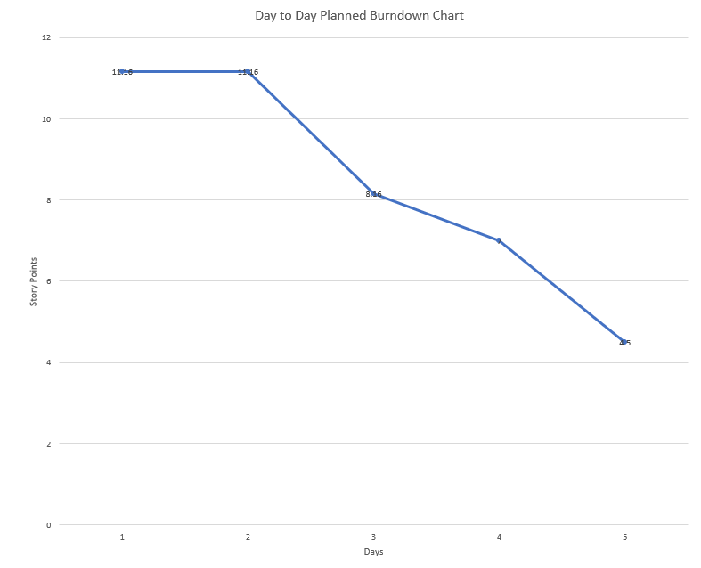
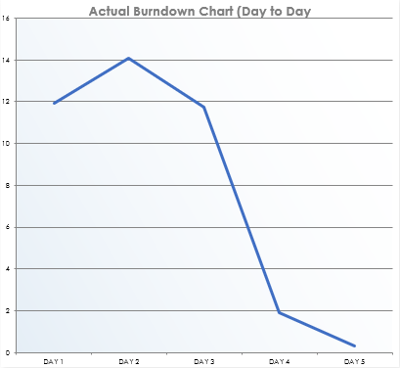
Burndown Chart (day-to-day)
VS
Notes:
Will add burndown chart in here.

Slide 7
Major problems during the sprint.
Notes:
There weren’t really any.
Can maybe talk about any user stories that weren’t complete if there are any.
Possibly #60 implementing co researchers seeing what they were assigned to.

Slide 8
What is left to implement for the product?
Overall visualisation of the product being improved (e.g. Data Visualisation and University Branding)
Adding researcher contact details at the end of the questionnaire
Even further questionnaire functionality, e.g.: editing and deleting questions once added, sending automatic email invites to participants when a questionnaire is ready to be complete
Allowing video synchronisation
Notes:
Have it so input boxes are not there all the time.
Passwords should be encrypted and have a confirmation (retype passwords) and hide passwords.

